Slide 1

Airlines Passenger Satisfaction Classification Project
By: Njood Alqahtani & Reem Alsuqaih

Slide 2
Table of Content
Introduction
Methodology
Experiments
Result

Slide 3
Introduction
What factors lead to customer satisfaction for an Airline? This dataset contains an airline passenger satisfaction survey. What factors are highly correlated to a satisfied (or dissatisfied) passenger? Can you predict passenger satisfaction?

Slide 4
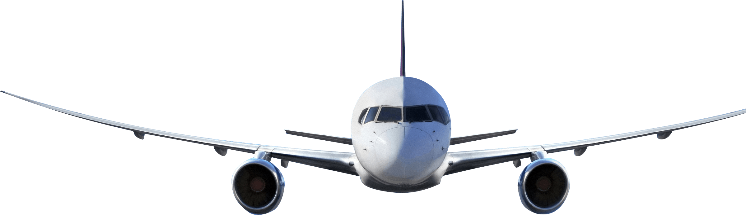
Methodology
Split the Data
3
Simple EDA
4
Experiments
2
Dataset Understanding
1
5
Result

Slide 5
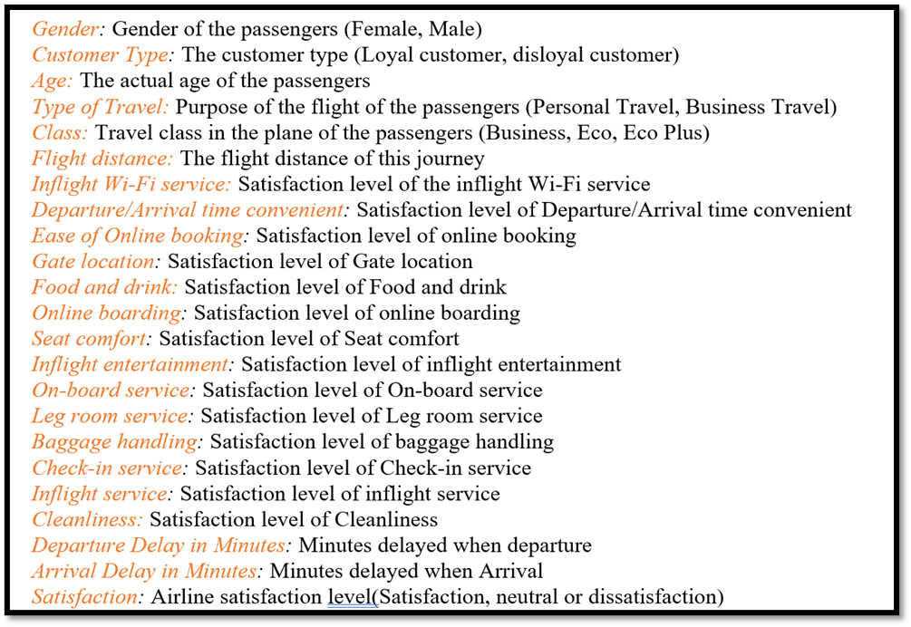
Data Understanding

Slide 6
Pre-processing the dataset & Simple EDA
To get started, we need to import some useful libraries that will help us import the dataset into our python environment, manipulate and analyze the same and later help us to visualize it.
Missing values & outliers was observed across the dataset, so a good approach it to either remove it or correct it.
Split the data and do different features engineering on it.
Check if our dataset is balance or not.

Slide 7
Experiments

Slide 8
Experiment 1 :Baseline Model
Train Score:
74.4 %
Test Score:
75.5 %
It shows the score percentage of baseline experiment
75%

Slide 9
Experiment 2: Logistic Regression
Train Score:
81.5 %
Test Score:
81.9 %
It shows the score percentage of logistic experiment
81%

Slide 10
Experiment 3: Standard Scale with the Grid search
Train Score:
87 %
Test Score:
87.1 %
It shows the score percentage of the experiment with scale and grid search
87%

Slide 11
Experiment 4: KNN Classifier
Train Score:
78 %
Test Score:
69.8 %
It shows the score percentage of experiment with the KNN classifier
78%

Slide 12
Experiment 5: Decision Tree Classifier
Best Score:
94.1 %
It shows the score percentage of experiment with decision tree classifier
94%

Slide 13
Experiment 6: Random Forest Classifier
Train Score:
97.35 %
Test Score:
94.74 %
It shows the score percentage of the experiment with random forest classifier
94%

Slide 14
Experiment 7: XGBoost
Best Score:
95.4 %
It shows the score percentage of the experiment with XGBoost
95%

Slide 15
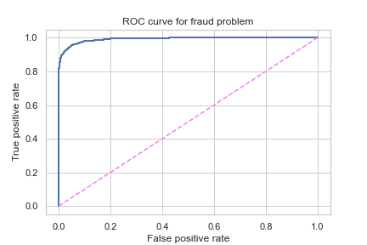
ROC Curve

Slide 16
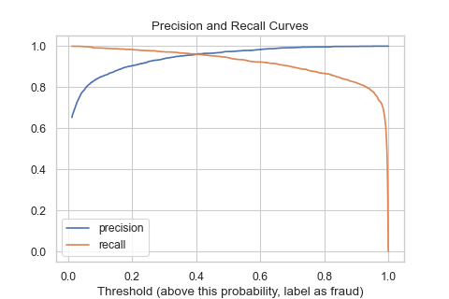
Precision & Recall For Best Model

Slide 17
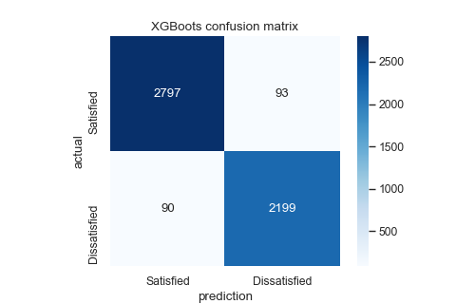
Confusion Matric For Best Model

Slide 18
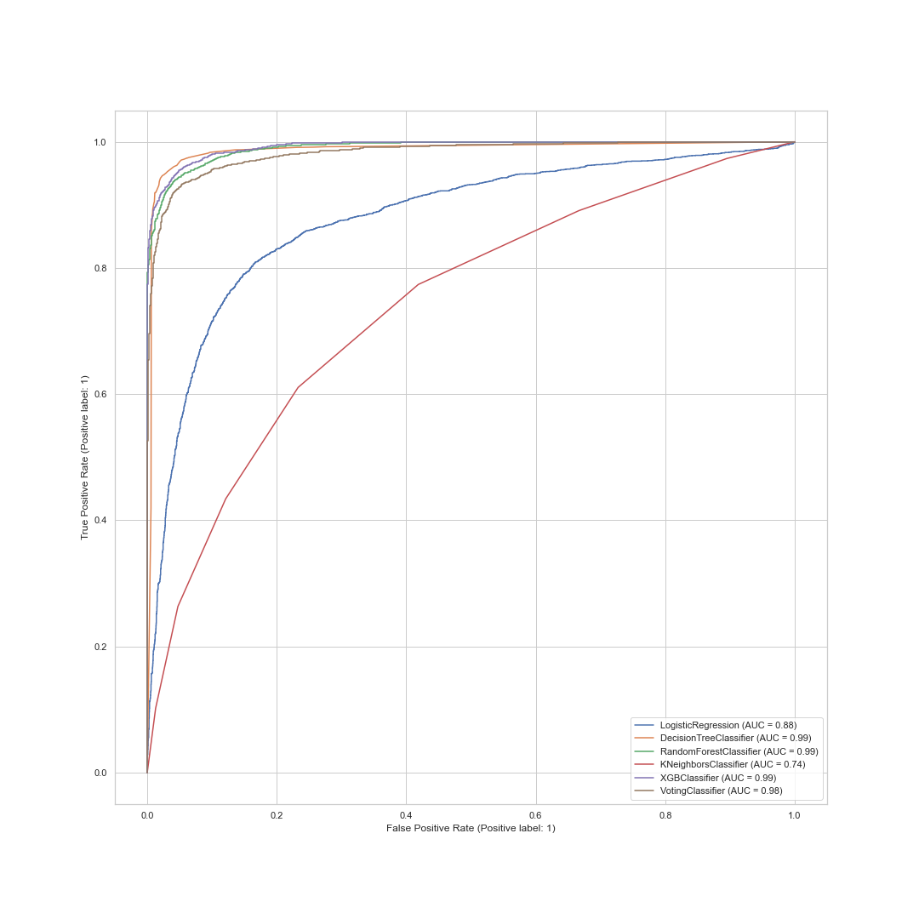
Conclusion
After doing the previous experiments, it shows that XGBoost scores the highest score, and the best threshold is 0.4

Slide 19
Thank you

